Slide 1
A GOOD PRESENTATION
ISABEL BARRERO, REBECA TOMÉ, OLMO VERGARA.

Slide 2
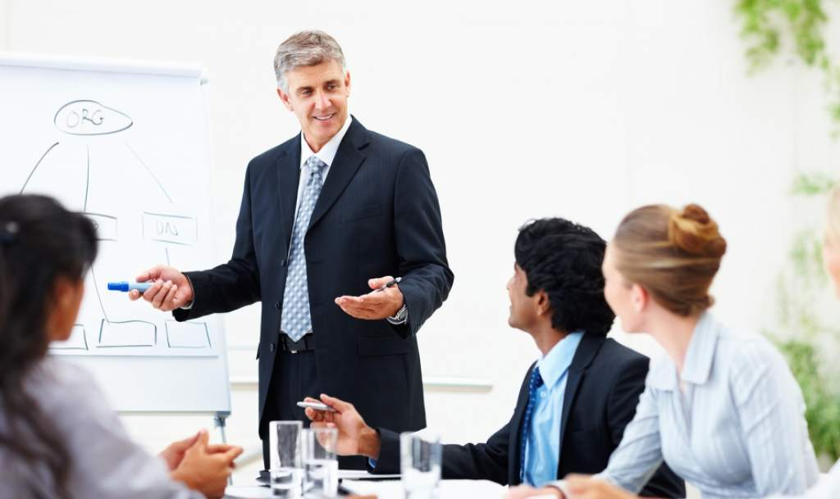
USEFUL TIPS FOR THE FACE.
POSITIVE BODY LANGUAGE
Make eye contact with the audience. But do not stare or look blankly into audience's eyes

Slide 3
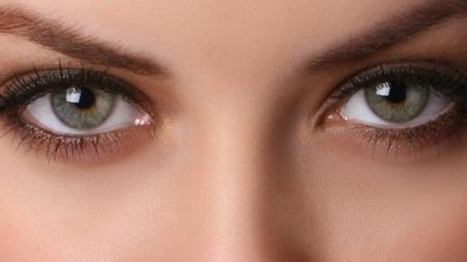
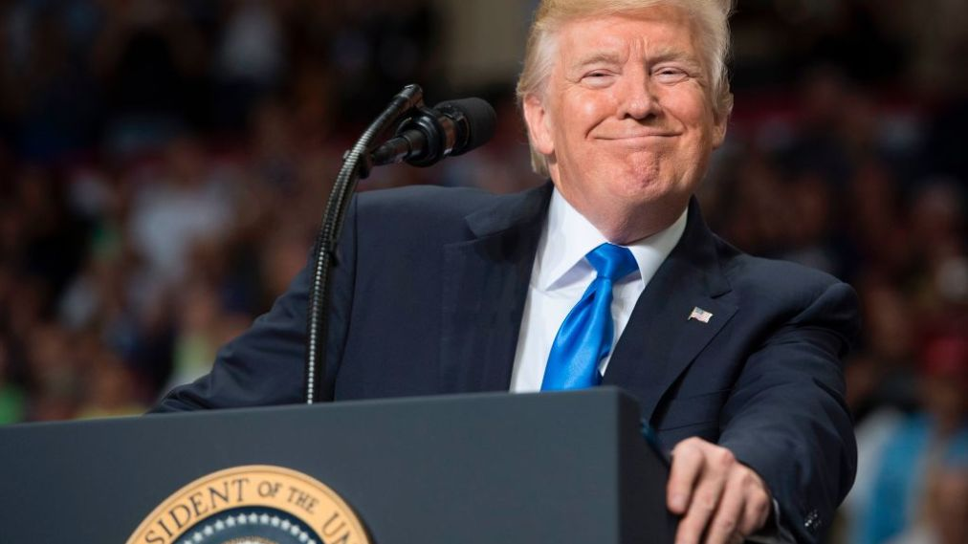
USEFUL TIPS FOR THE FACE.
POSITIVE BODY LANGUAGE
Facial expressions should be natural and friendly. Creating a peaceful atmosphere.
Maintain open eyes wide.

Slide 4
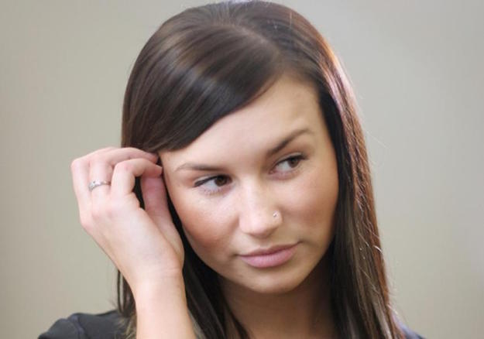
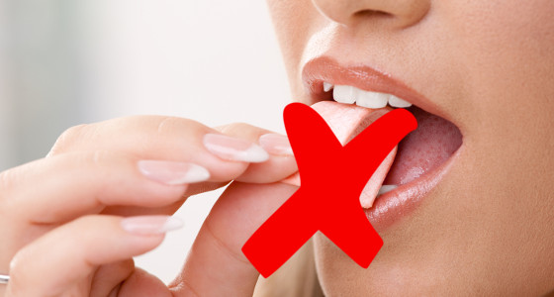
USEFUL TIPS FOR THE FACE.
NEGATIVE BODY LANGUAGE
Do not play with your hair.
You cannot expose with gum.

Slide 5
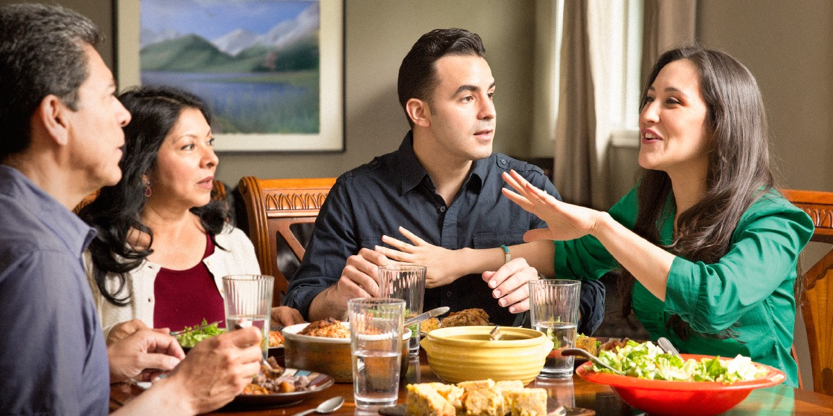
USEFUL TIPS FOR THE FACE.
NEGATIVE BODY LANGUAGE
Do not talk when the rest of your group is talking.

Slide 6

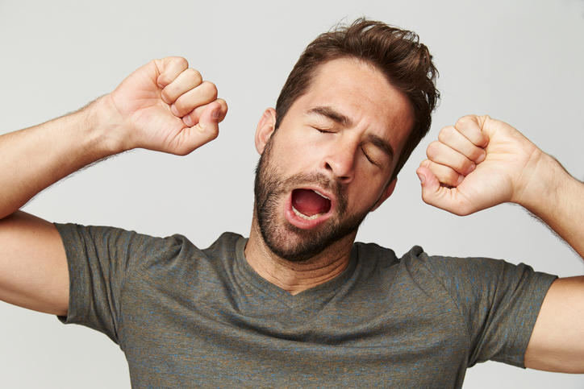
USEFUL TIPS FOR THE FACE.
NEGATIVE BODY LANGUAGE
Do not yawn.
Do not touch or cover your face.

Slide 7


USEFUL TIPS FOR YOUR BODY.
POSITIVE BODY LANGUAGE
Maintain your trunk straight but relaxed.
You can move to indicate a change of focus.

Slide 8

USEFUL TIPS FOR YOUR BODY.
POSITIVE BODY LANGUAGE
Move forward to emphasize what you are saying.

Slide 9
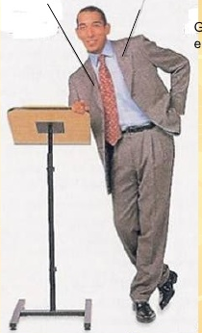

USEFUL TIPS FOR YOUR BODY.
NEGATIVE BODY LANGUAGE
Do not rest your body in the desk or wherever.
Do not show your back to the public.

Slide 10
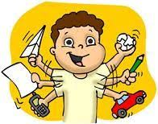
USEFUL TIPS FOR YOUR BODY.
NEGATIVE BODY LANGUAGE
Do not fidget.

Slide 11
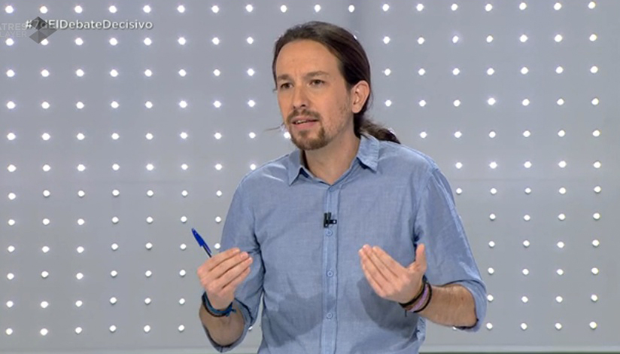
USEFUL TIPS FOR YOUR HANDS.
POSITIVE BODY LANGUAGE
You can bring to your presentation something like a pen. This will relax you.

Slide 12
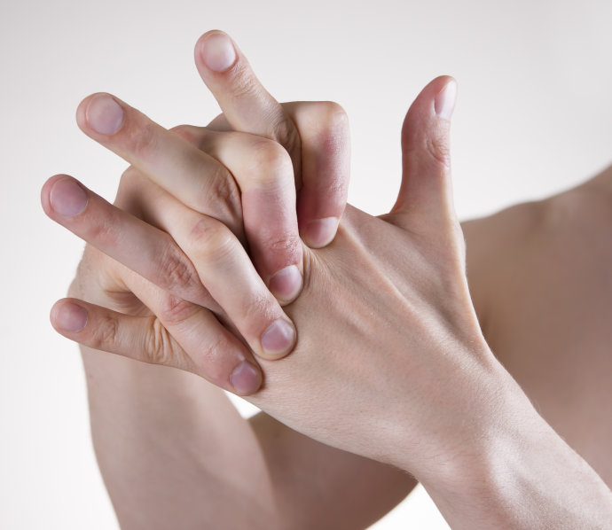
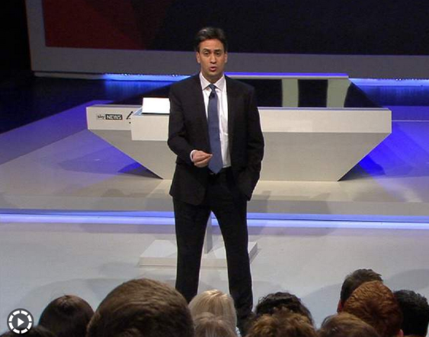
USEFUL TIPS FOR YOUR HANDS.
NEGATIVE BODY LANGUAGE
Avoid playing with your fingers. This show your nervousness
Do not put your hands in pockets.

