Slide 1

Non verbal communication tips
Juan Brieva, Víctor Díez and Alonso Cuadrado

Slide 2

Things you must do

Slide 3
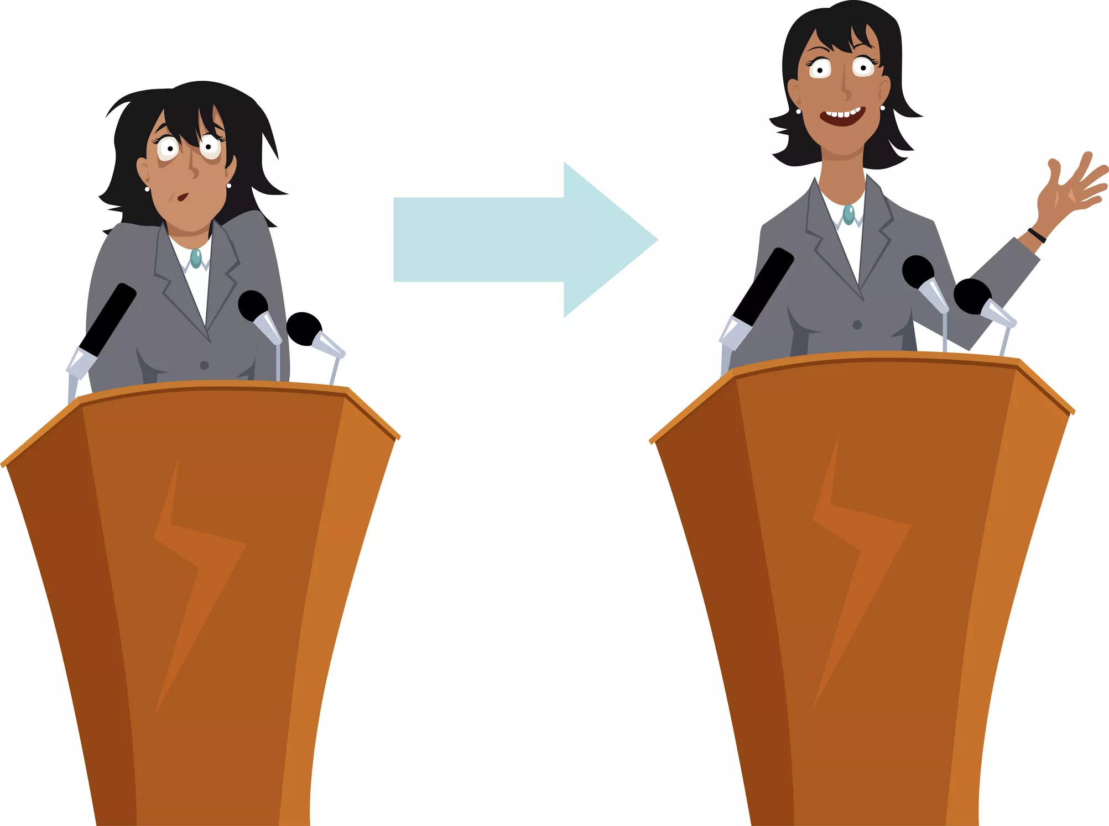
Stand straight but relaxed

Slide 4
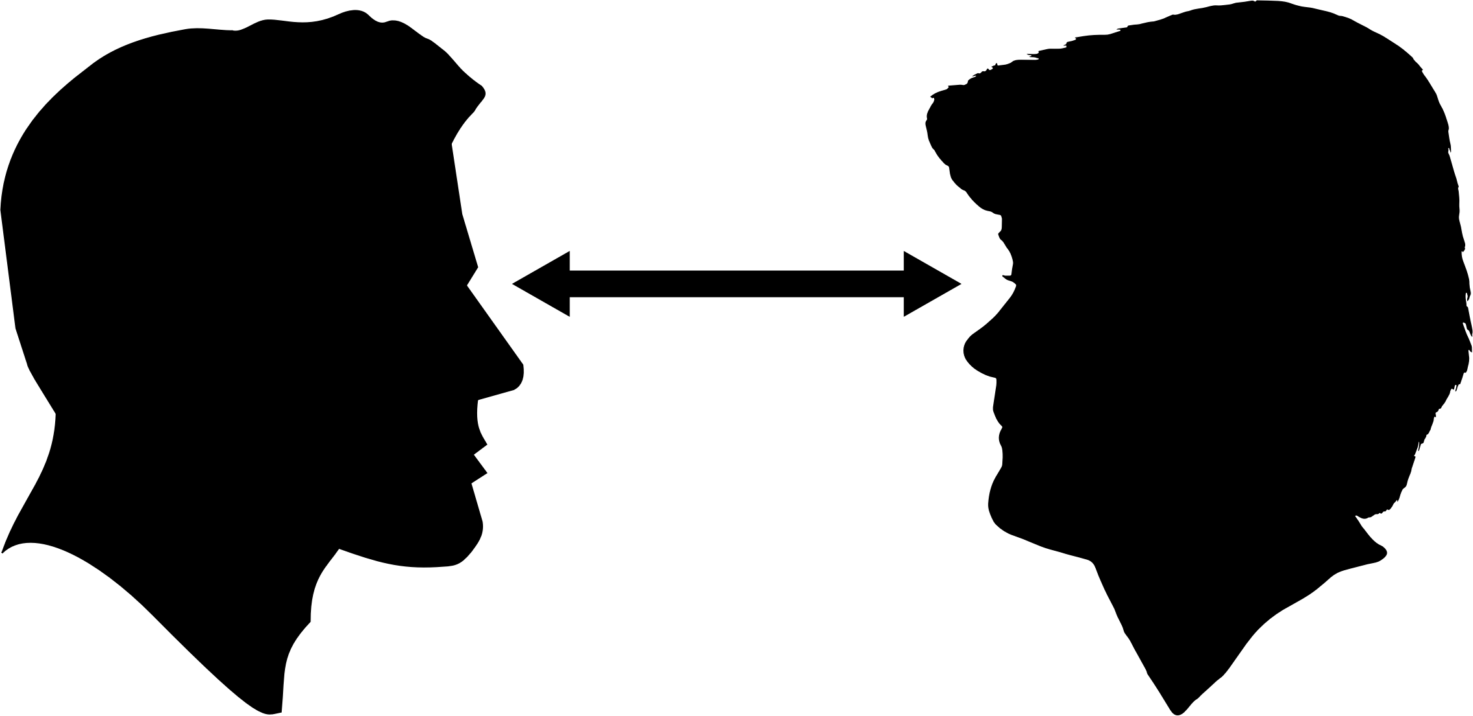
Mantain eye contact with ALL the audience

Slide 5
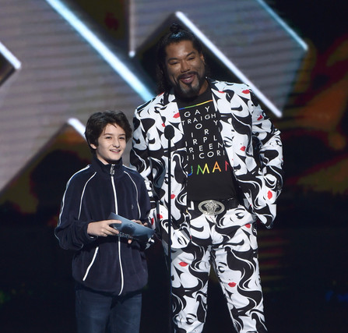
Have a natural and friendly facial expresion

Slide 6
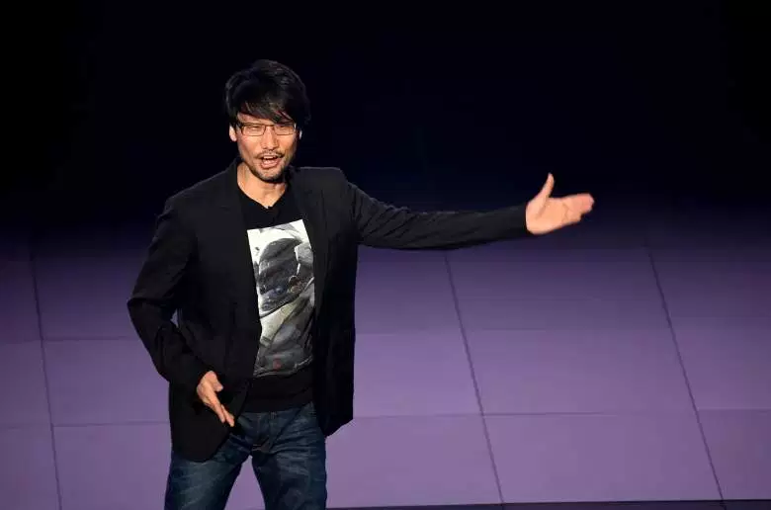
Move to indicate a change of focus, to keep the audience’s attention

Slide 7
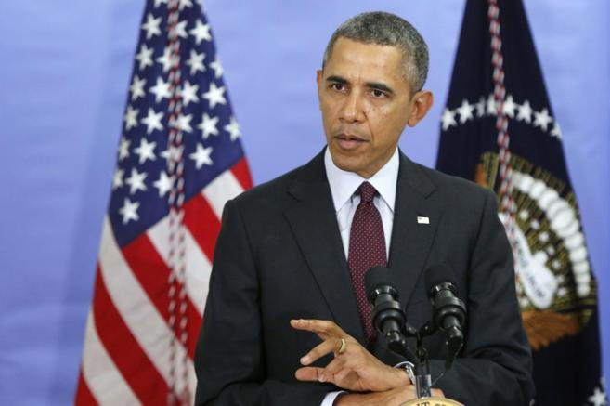
Speak clearly and calmly and with short and understandable sentences

Slide 8

Things you mustn't do

Slide 9


Keep your hands in you pockets

Slide 10


Having a nervous twitch

Slide 11

Speak turned back to the audience

Slide 12

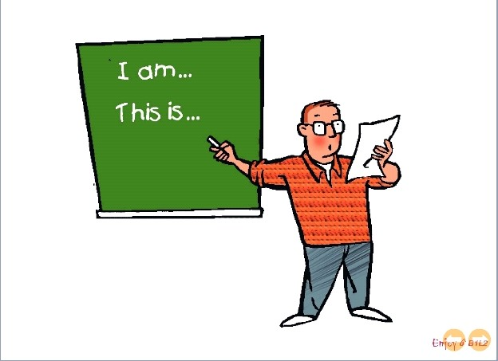
Look at your notes or at the board

Slide 13
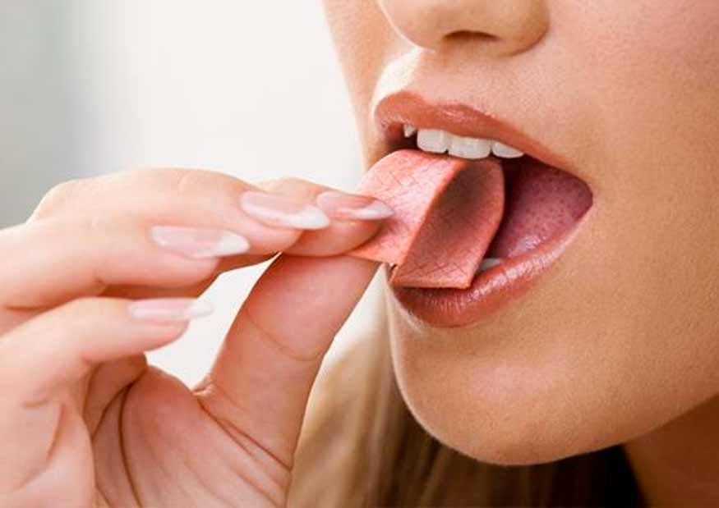
Eat gums in the presentation

